Slide 1
League of Legends
A technical manual by Levi George

Slide 2
Why League of Legends?
League of Legends is massively popular with millions of players worldwide
League is a game that I have recently become addicted to
League has a level of depth that makes it a mind game at times making it very fun when you learn and improve skills to conquer your enemies.
League also has lots of coverage on YouTube and other websites
There is a subreddit dedicated solely to helping players improve (r/Summoner’sSchool)
This data is wide-spread and difficult to find and use at times
This manual will solve the issues of information gathering making it easier for players to learn and improve without spending so much time searching.

Slide 3
What is League of Legends?
League of Legends (or just League) is a MOBA (Multiplayer Online Battle Arena)
Each team will have five players and both teams must work to break through each team’s defenses and destroy their Nexus.
Each player has a specific role they must fulfill to win the match
However, there are also numerous mechanics and thought processes that must apply. They come in two forms:
Micro Decisions (or just Micro)
Macro Decisions (or just Macro

Slide 4
Objectives of the Manual
Make it easy to find information
Document will have lots of information and sources for players to refer to.
Make it easy to use information
Help familiarize players with monsters in the game
Help familiarize players with League Lingo

Slide 5
Basic Concept: Wave Manipulation
“wave” refers to a group of minions that will walk down a lane until they meet some enemy
The “waves” have a natural rhythm, it will randomly push toward one tower until the waves reaches it, at this point it will push back towards the opposite tower.
By selectively and carefully culling enemy minions, you can slowly push or freeze the wave.
This lets you keep it in a place that makes the enemy vulnerable
By killing the minions quickly then you can push the wave, this will increase the tempo

Slide 6
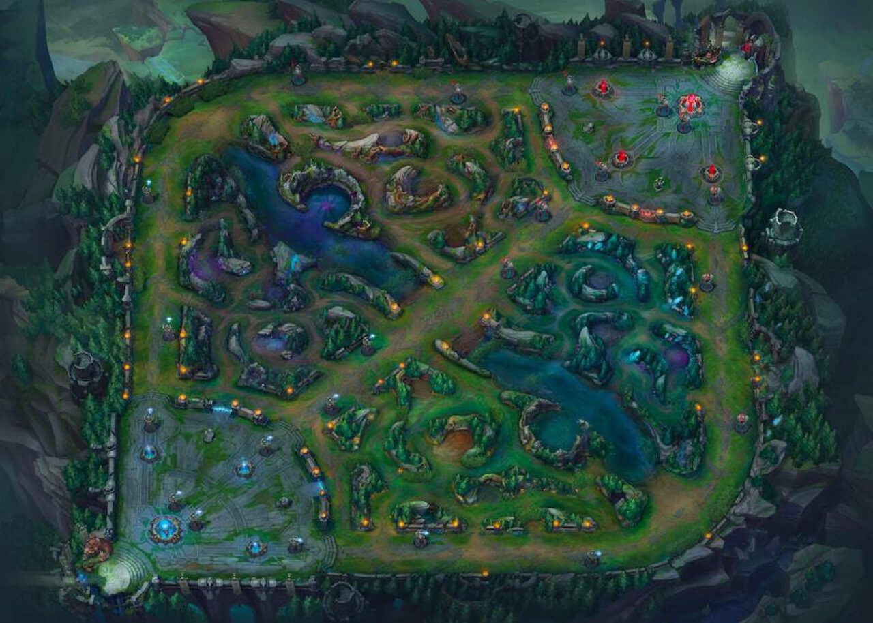
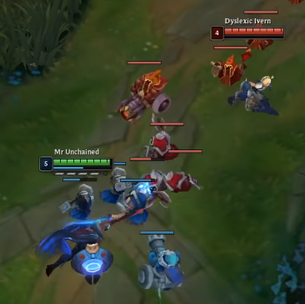
Basic Concept: Wave Manipulation

Slide 7
Sources
https://www.surrenderat20.net/2019/12/red-post-collection-unleashing-elements.html (Map of Summoner’s Rift)
https://www.youtube.com/watch?v=G5vs570lb2I&ab_channel=Keegun (Image of two minion waves clashing)

